Slide 1
UNIT-4
Advanced Data structures Internet algorithms: Tries-Insert, Search operations and Delete operations. Hashing Techniques Hash Tables Direct-address tables, Hash tables, Hash functions, Open addressing and Perfect hashing.

Slide 2
Tries
The basic tool for string data structures, similar in role to the balanced binary search tree, is called “trie”
Derive from “retrieval.” (Pronounced either try or tree)
In this tree, the nodes are not binary. They contain potentially one outgoing edge for each possible character, so the degree is at most the alphabet size |A| .

Slide 3
Tries cont.
Prefix Vs. Suffix.
Ex. “computer”.
Prefix:(c, co, com).
Suffix: (r, er, ter)
Each node in this tree structure corresponds to a prefix of some strings of the set.
If the same prefix occurs several times, there is only one node to represent it.
The root of the tree structure is the node corresponding to the empty prefix.

Slide 4
Tries
A trie data structure gives us advantages over a hash table mainly in the following factors:
Prefix-based searching can't be done with a hash table.
There are no collisions in a trie data structure which means a better worst-case time complexity than a hash table
Hash functions are not used in a Trie data structure.

Slide 5
Properties of a Trie Data Structure
The structure of a trie is like that of a tree.
Each trie consists of a root node.
The root node branches into various child nodes having multiple edges.
Each TrieNode consists of an array of pointers where every index of the array represents a character.
Each node of a trie represents a string and each edge represents a character.
The root node is an empty string.
Each node except the root node is a string having characters along the path from the root to that node.

Slide 6
Tries
Standard Tries
Compressed Tries
Suffix Tries

Slide 7
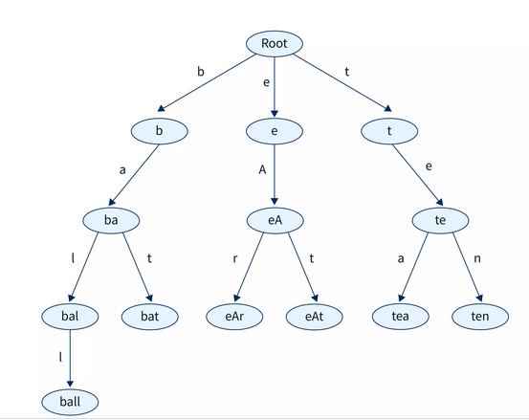
Trie data structure : Example.
The diagram above shows a trie data structure with input strings as ball, bat, eAr, eAt, tea, and ten.
We can see that every node represents a part or prefix of the given strings.
The root node represents an empty string.
Each edge is represented by a character.
Every level of the Trie data structure represents a prefix of a given length.
If we consider the root node to be at level 0.
Then the root node represents a prefix of length 0 or an empty string.
Level 1 of the Trie represents a prefix of length 1 and so on.
Two child nodes have the same ancestors if tea and ten have the same ancestors which are te and t. This is because they share the same prefix of te.

Slide 8
Trie Data Structure
Note that we can include any number of characters in our Trie data structure ranging from alphabets, numbers, and special characters.
We will discuss strings with characters a-z.
Thus for every node in the Trie, we will need an array of pointers of size 26. Where the 0th index will represent ‘a’ and the 25th index will represent ‘z’.
Another important thing to note is that every string in the Trie data structure is sorted lexicographically from left to right.

Slide 9
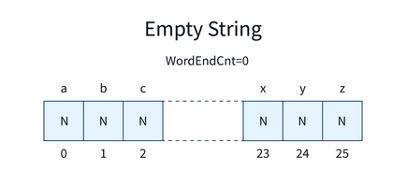
Trie Data Structure
Before inserting any string into the Trie we create a root node for the Trie.
The structure of the root node will be as follows.
The root consists of an empty string and 26 pointers each initialized with NULL.
N in the diagram represents a NULL value at every index.

Slide 10
A = {a, c, e}
Strings:
aaa
aaccee
ac
cc
cea
cece
eee
e
c
a
A
A
A
cc
ce
aa
ee
ac
A
A
A
A
A
cec
cea
aac
aaa
eee
A
A
A
A
A
ceca
aacc
A
A
aacce
A
aaccee
A

Slide 11
Tries Example
Example: standard trie for the set of strings
S = { bear, bell, bid, bull, buy, sell, stock, stop }

Slide 12
String Termination
Strings are sequences of characters from some alphabet. But for use in the computer, we need an important further information: how to recognize where the string ends.
There are two solutions for this:
1. We can have an explicit termination character, which is added at the end of each string, but may not occur within the string “\0” (ASCII code 0) , or
2. We can store together with each string its length.

Slide 13
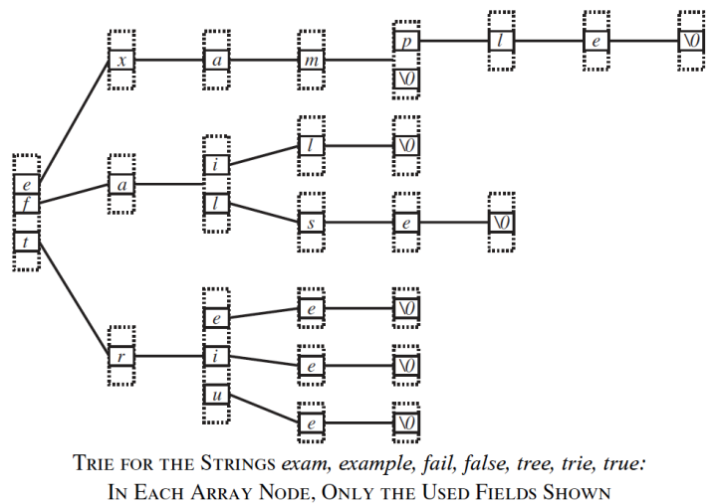
Termination Example

Slide 14
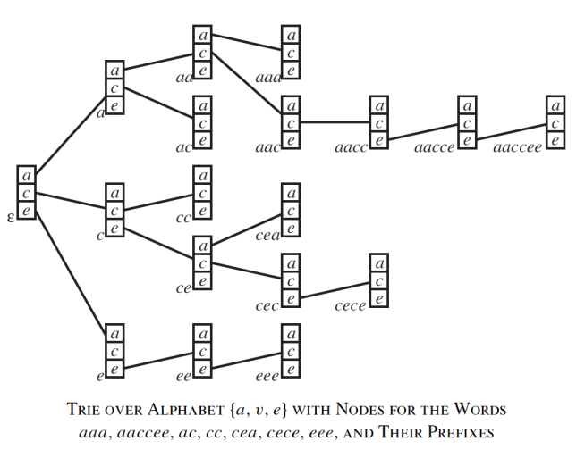
Tries Example

Slide 15
Strings:
exam
example
fail
false
tree
trie
true
t
f
e
r
a
x
u
i
e
l
i
a
e
e
e
s
l
m
\0
\0
\0
e
\0
\0
p
\0
l
e
\0

Slide 16
String Termination
The use of the special termination character ’\0’ has a number of advantages in simplifying code.
It has the disadvantage of having one reserved character in the alphabet that may not occur in strings.
There are many nonprintable ASCII codes that should never occur in a text and ’\0’ is just one of them.
There are also many applications in which the strings do not represent text, but, for example, machine instructions.

Slide 17
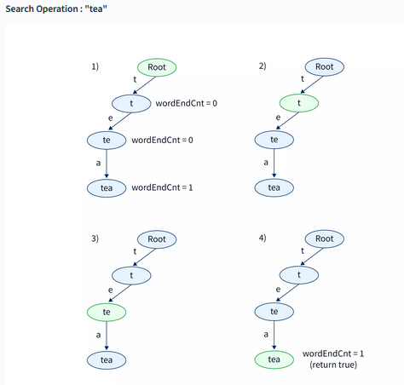
Find, Insert and Delete
To perform a find operation in this structure:
Start in the node corresponding to the empty prefix.
Read the query string, following for each read character the outgoing pointer corresponding to that character to the next node.
After we read the query string, we arrived at a node corresponding to that string as prefix.
If the query string is contained in the set of strings stored in the trie, and that set is prefix-free, then this node belongs to that unique string.

Slide 18
Insert Operation in a Trie
Insert operation - we can insert new strings into the Trie data structure.
The structure of a Trie node consists of strings with character a-z.
Every Trie node will have a character pointer array of size 26.
We will create the structure of a TrieNode as follows-
Each TrieNode will have 26 children from a-z represented by a character pointer array.
Each node will have a wordEndCnt integer variable.
This variable will store the count of the strings in the Trie which are the same as that of the prefix represented by that node of the Trie.
Inside the structure of a TrieNode we made a constructor TrieNode() which will initialize every index of the childNode pointer array with NULL whenever a new node is created.
It will also initialize the wordEndCnt value for every node with 0.

Slide 19
Find, Insert and Delete
To perform an insert operation in this structure:
Perform find
Any time we encounter a nil pointer we create a new node.
Example:
Insert “extra”
e
x
t
a
r
m
a
\0
\0

Slide 20
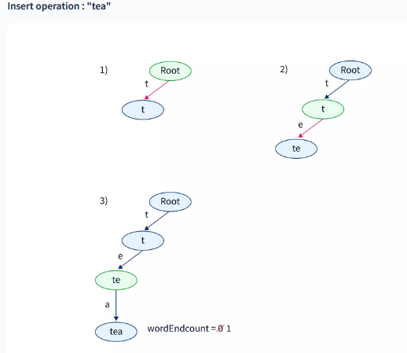
Insert Operation - Trie
The diagram above shows the steps for insertion of the string tea in the Trie

Slide 21
Find, Insert and Delete
To perform a delete operation in this structure:
Perform find
Delete all nodes on the path from ‘\0’ to the root of the
tree unless we reach a node with more than 1 child
Example:
Delete “extra”
e
x
t
a
r
m
a
\0
\0

Slide 22
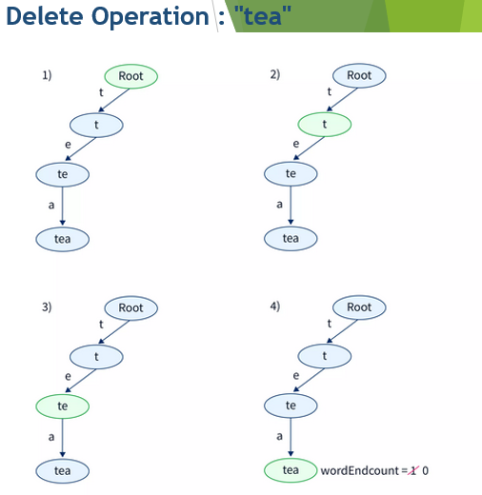
Delete Operation : "tea"
At first, we search for the string tea using the same logic discussed in the search operation in a Trie.
As the string tea is present in the Trie the current node pointer will move from the root node to the last node.
The last node represents the string tea.
Now we will check if the wordEndCnt for this node is greater than 0 or not.
As in this case, the wordEndCnt for the node is greater than 0 we reduce the wordEndCnt for this node and return True.
Note that if we again try to delete the string tea from the Trie after the above operation.
We will not be able to delete the string as there was only one tea string the Trie and we already deleted that string.
If we try to delete the string then for the last current node we will get the wordEndCnt for the value as 0. So we return a boolean false value.

Slide 23
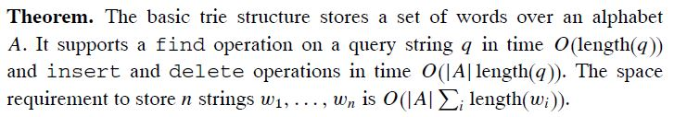
Performance
Find: All the characters in the word = O(|q|) where q: query string
Insert: first find then insert an array of length |A| as a node = O(|q|.|A|)
Delete: first find then delete an array of length |A| as a node = O(|q|.|A|)
We can get rid of the |A| dependence in the delete operation by using
reference counts.
All new nodes must be initialized with NULL pointers,
so the |A| dependence in the insert operation does not disappear.

Slide 24
Performance
A standard trie uses O(n) space. Operations (find, insert, remove) take time O(dm) each, where:
-n = total size of the strings in S,
-m =size of the string parameter of the operation
-d =alphabet size,

Slide 25
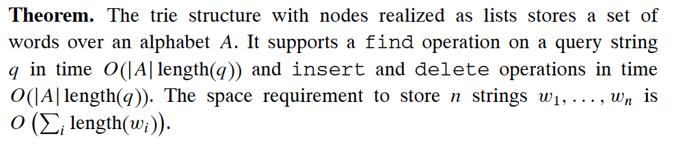
Lists Performance
Find, Insert and delete: O(|q|.|A|)

Slide 26
Standard Tries
The standard trie for a set of strings S is an ordered tree such that:
each node but the root is labeled with a character
the children of a node are alphabetically ordered
the paths from the external nodes to the root yield the strings of S
Example: standard trie for
the set of strings
S = { bear, bell, bid, bull,
buy, sell, stock, stop }

Slide 27
Compressed Tries
Trie with nodes of degree at least 2
Obtained from standard trie by compressing chains of redundant nodes
Standard Trie:
Compressed Trie:

Slide 28
Compact Storage of Compressed Tries
A compressed trie can be stored in space O(s), where s = |S|, by using O(1) space index ranges at the nodes

Slide 29
Applications of a Trie Data Structure
Autocomplete Feature - Trie data structures are commonly used in implementing the autocomplete features that we see in search engines.
If we type a prefix of the desired string then we will see suggestions of many strings that will have the same prefix.
This can be efficiently implemented with the help of a Trie as in a Trie the strings having a common prefix share the same ancestors.
We can then search at levels below these ancestors and show suggestions based on the popularity of different strings that we come across.
Spell Checkers - Spell Checkers check whether the typed word is present in the dictionary or not. If the word is not present in the dictionary then it shows suggestions based on the typed word.
It may also sort the suggestions based on their popularity. A dictionary can be efficiently implemented using a Trie.
String Matching Algorithms - Trie data structures can also be used in string matching algorithms to match a given pattern among a collection of strings.

Slide 30
Advantages & Disadvantages of Trie Data Structure
Advantages of Trie Data Structure
Tries can implement insert and search operations faster than a binary search tree. Tries are also faster than hash tables as there are no hash functions and collisions in a Trie.
Tries can be used to order the strings in alphabetical order.
Tries can be used to implement prefix-based searching which can't be implemented using a Hash Table. This helps in implementing features like autocomplete and spell checks on a given word.
Disadvantage of Trie Data Structure
The main disadvantage with Trie is that they take a lot of memory for storing strings as compared to other data structures. This is because each node consists of an array of pointers for the child nodes and also contains some additional variables like the wordEndCnt variable we used in the TrieNode structure.

Slide 31
Conclusion
The time needed for building a Trie data structure is O(N*x). Here N is the number of strings we want to insert in Trie and x is the average length of the strings we want to insert.
Using a Trie data structure we can insert, search and delete keys in a time complexity of O(k) where k is the length of the key.
The only disadvantage of using a Trie data structure is that they may end up taking more space than other data structures.
Trie data structures have many practical applications. Some common examples are auto-completing features, dictionaries, and spell checkers.

